Slide 1
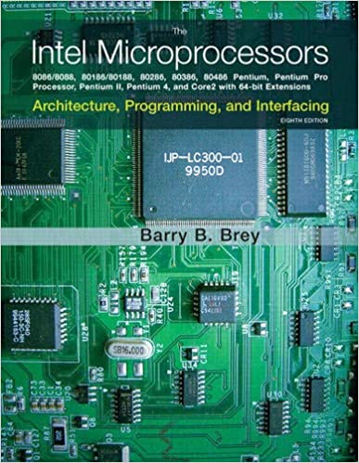
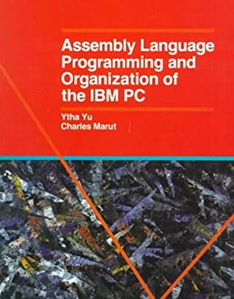
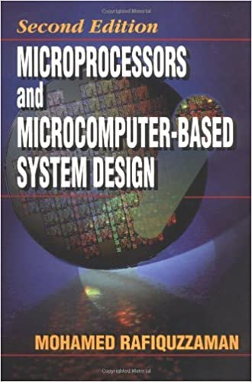
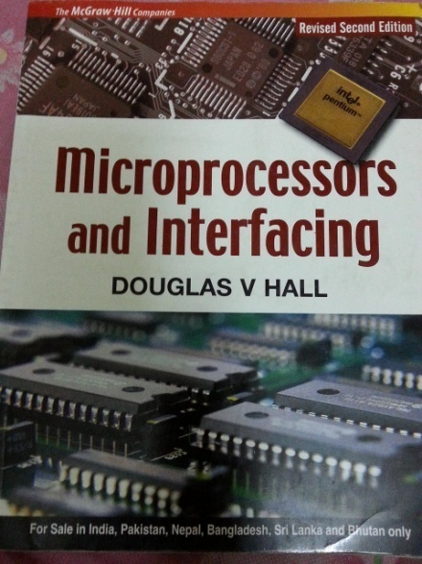
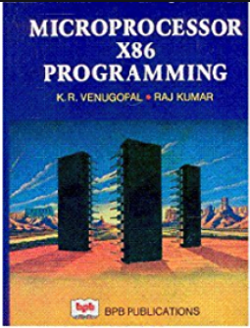
CSE 442: Microprocessor and Microcontroller
Prerequisite : Digital Electronics
Text Book:

Slide 2
Recap prerequisite knowledge:
Number System: Binary, Decimal and Hexadecimal
D-FF and Registers: Clocked D-FF, Parallel-in-parallel-out 8-bit/16-bit registers.
Memory System: RAM and ROM architecture
What is the value of binary 11₂?
Hexadecimal number system is the short form of binary number system.
What is the value of 127₁₀ in binary and hexadecimal? 0111 1111₂ , 7F₁₆

Slide 3
Recap prerequisite knowledge:
Number System: Binary, Decimal and Hexadecimal
Binary number : 0 – 15
0000
0001
14 = 1110 = E
Hexadecimal : 0 - F

Slide 4


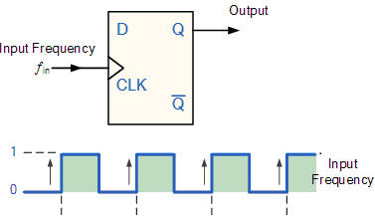
Review of Clock and D-FF:
D = 1
PGT: Positive Going Transition
When an active clock pulse is applied D-FF stores the data bit given in D input (0 or 1). This bit is stored in the D-FF unless another bit is stored. When a new bit is stored the old-bit is over-written by the new one.

Slide 5
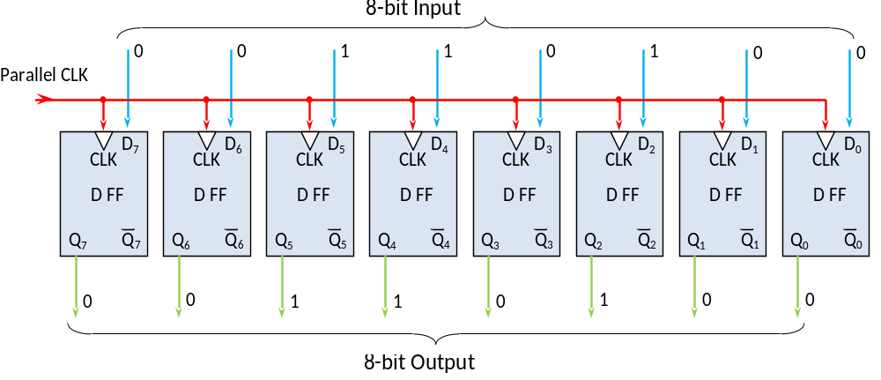
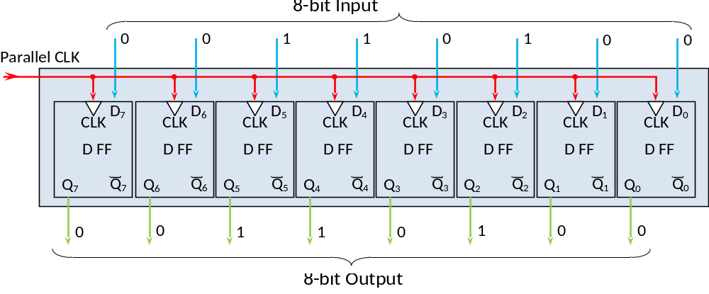
Registers from D-FF:
Connecting eight D-FFs an 8-bit register is developed.
D-FFs are considered inside a box.

Slide 6
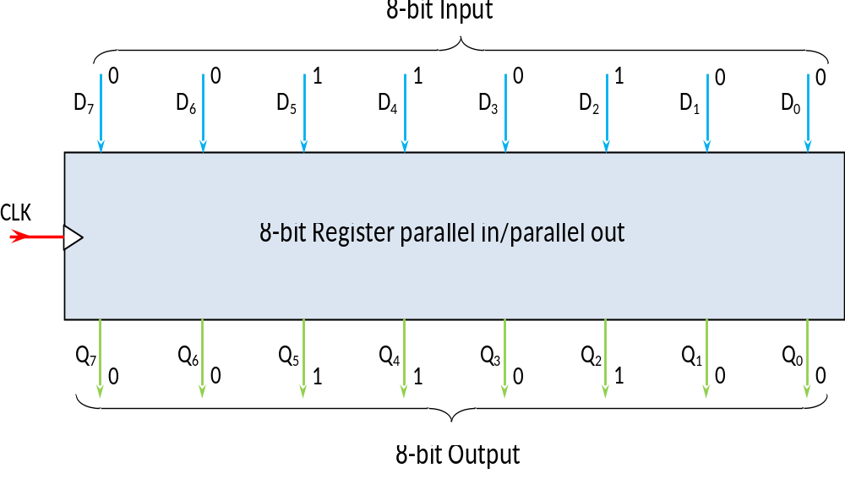

Registers from D-FF:
8 register
8 register
8 register
8 register
8 register
Same diagram, but internal D-FFs are not shown.
8 register
8 register
8 register
8 register
The whole register is represented by a small block. It has inputs and outputs but not shown.
8 register
8 register
8 register

Slide 7
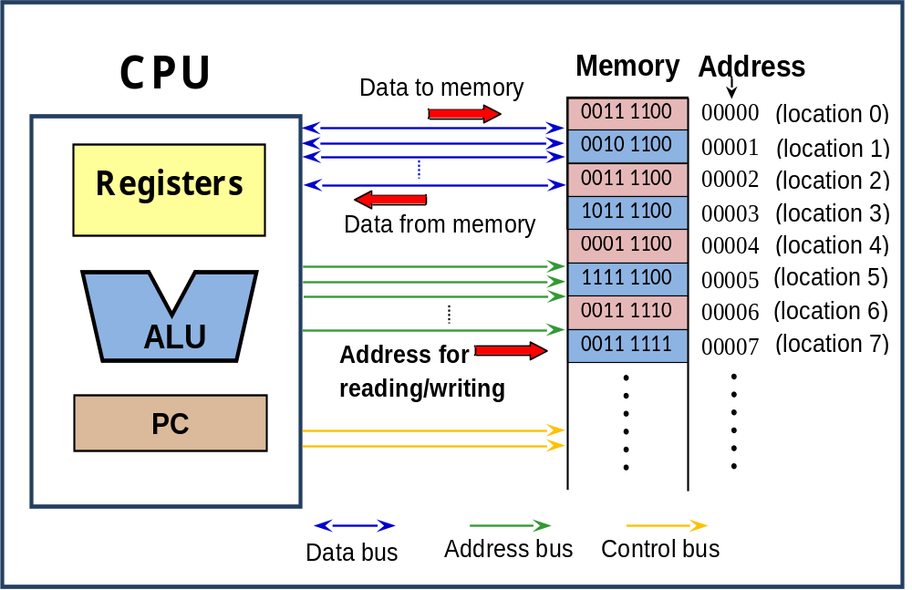
A7E H = 1010 0111 1110₂
Logical connection between the microprocessor and memory unit
WRITE
Bidirectional
H
READ
Unidirectional
Unidirectional

Slide 8
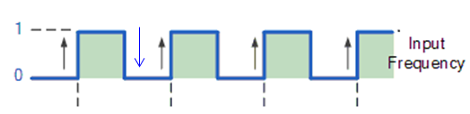
What is a Microprocessor: A Microprocessor is a multipurpose, programmable, clock-driven, register-based electronic device that reads binary instructions from a storage device called memory; accepts binary data as input and processes data according to those instructions, and provides results as output.
Some features of microprocessor: The microprocessor uses the same type of logic that is used in a digital computer's central processing unit (CPU). Since its function is to process data, we can call it a Processor.
Because of its resemblance to the CPU (processor), and because it is constructed with microcircuit (integrated circuit) technology, we say it is a microprocessor.
Like the CPU, the microprocessor has digital circuits for data handling and computation under program control. In other words, the microprocessor is a data processing unit.
Integrated Circuit (IC)
Clock: a pulse train. Square wave

Slide 9
Data processing is the microprocessor's main function. Data processing includes both computation and data handling. Computation is performed by logic circuits that make up what is usually called the arithmetic and logic unit (ALU).
These logic circuits enable us to use functions that cause data changes. Among these functions are Add, Subtract, AND, OR, Compare, Increment, and Decrement

Slide 10
The ALU cannot itself move data from place to place. Instead, the ALU merely performs an operation on whatever data it finds in certain places, and it leaves the result in the same place.
The microprocessor has other logic circuits, outside the ALU, that handle data. This data-handling logic (circuit) moves data into such a place that the ALU can process the data. After the processing, the data-handling logic moves the data elsewhere.
Decoder: In order to process data, the microprocessor must have control logic which tells the ALU how to execute the program—a set of instructions for processing the data. We can call this unit a decoder, as it decodes or translates the instruction into a form that the ALU can understand.
Three Steps of OP: The control logic helps the microprocessor to steps through the stored program (instructions) in memory. It calls (or fetches) them one at a time. After the instruction is fetched, the microprocessor's control logic (decoder) decodes the instruction. Then the ALU carries out (executes) the decoded instruction.
The instructions that you store in memory determine what the microprocessor will do.

Slide 11
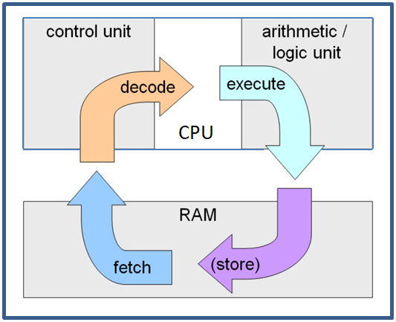
To review: The microprocessor's purpose is to process data. The microprocessor operates in the following steps.
First, the microprocessor fetches (gets) an instruction. Then the control logic decodes what the instruction says to do. After decoding, the microprocessor executes (carries out) the instruction. These steps are called the fetch-and-execute cycle, or the fetch/execute cycle. For each instruction in memory, the microprocessor goes through one fetch-and-execute cycle.

Slide 12
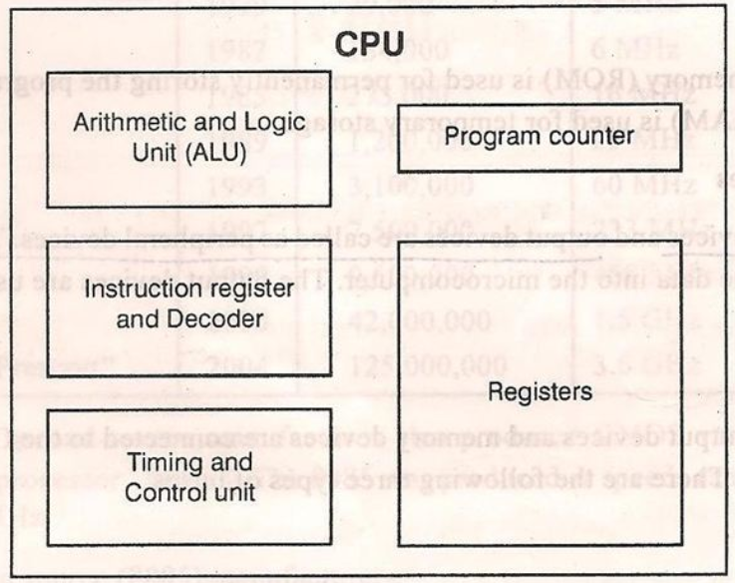
Components of a Basic Microprocessor:
Registers: are very fast and very small memory units. They help to store data and instructions.
Instruction Register: stores the instruction to be executed. The decoder decodes the instruction for the ALU.
ALU: executes the decoded instructions.
Program Counter: points the instruction to be executed next.
Timing and Control: fetches instructions and data and provides timing.

Slide 13
What is a microcomputer: The microcomputer is a complete computing system built around a microprocessor. A complete computing system has a microprocessor-based CPU, and it has memory and input/ output function.
Power of a microprocessor: What we mean by the power of a microprocessor is its capacity to process data. There are three main measures of the power of a microprocessor: 1) the length of the microprocessor's data word; 2) the number of memory words that the microprocessor can address; and 3) the speed with which the microprocessor can execute an instruction.
The width of the data bus = word-length of the microprocessor
The memory capacity = 2 ^ n : n= width of the address bus

Slide 14
Evolution of Microprocessor (Book-Barray) : The history of microprocessor evolved since 1971 when Intel developed the world’s first microprocessor 4004. It was a four bit microprocessor. The other successive processors are shown in table 1.1.

Slide 15
Width of data/address bus= 8 bit / 16 bit
Processor | Year of Introduction | Number of Transistor | Initial Clock Speed | Address Bus | Data Bus | Addressable Memory | Package
4004 | 1971 | 2,300 | 108 kHz | 10-bit | 4-bit | 640-bytes | 16-pin DIP
8008 | 1972 | 3,500 | 200 kHz | 14-bit | 8-bit | 16 K | 18-pin DIP
8080 | 1974 | 6,000 | 2 MHz | 16-bit | 8-bit | 64 K | 40-pin DIP
8085 | 1976 | 6,500 | 5 MHz | 16-bit | 8-bit | 64 K | 40-pin DIP
8086 | 1978 | 29,000 | 5 MHz | 20-bit | 16-bit | 1 M | 40-pin DIP
8088 | 1979 | 29,000 | 5 MHz | 20-bit | 8-bit* | 1 M | 40-pin DIP
80286 | 1982 | 134,000 | 8 MHz | 24-bit | 16-bit | 16 M | 68-pin PGA
80386 | 1985 | 275,000 | 16 MHz | 32-bit | 32-bit | 4 G | 100-pin PGA
80486 | 1989 | 1.2 M | 25 MHz | 32-bit | 32-bit | 4 G | 168-pin PGA
Pentium | 1993 | 3.1 M | 60 MHz | 32-bit | 32/64-bit | 4 G | 296-pin PGA
Pentium Pro | 1995 | 5.5 M | 150 MHz | 36-bit | 32/64-bit | 64 G | 387-pin PGA
Pentium II | 1997 | 8.8 M | 233 MHz | 36-bit | 64-bit | 64 G | 242-pin SECC
Pentium III | 1999 | 9.5 M | 650 MHz | 36-bit | 64-bit | 64 G | 330-pin SECC2
Pentium 4 | 2000 | 42 M | 1.4 | 36-bit | 64-bit | 64 G | 478-pin PGA
- | - | - | - | - | - | -
Core i7 | 2008 | 731 M | 2.6 GHz | 36-bit | 64-bit | 64 G/1 TB | 1366-LGA
*Externally 8-bit, but internally 16 bit
DIP = Dual In-line Package
SECC = Single Edge Contact Cartridge
PGA = Pin Grid Array, LGA = Land Grid Array
Data bus width = Word length of the microprocessor
Addressable memory = 2^{N}
where N is the width of address bus

Slide 16
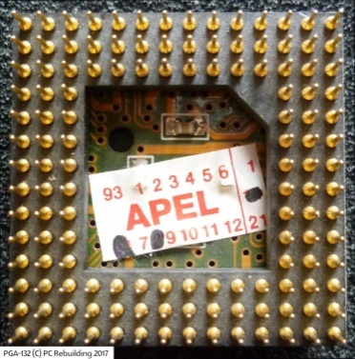
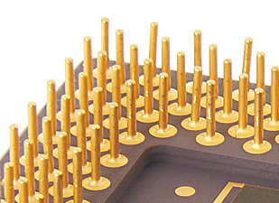
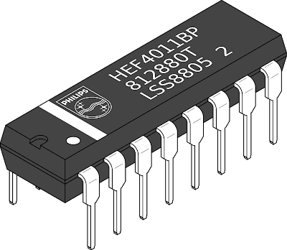
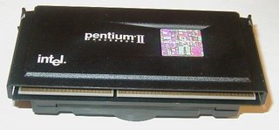
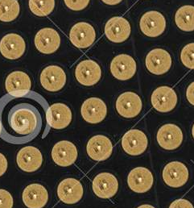
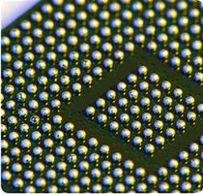
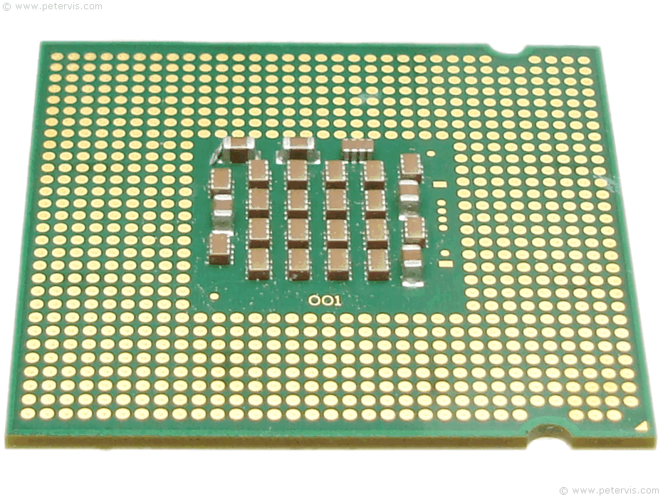
DIP
PGA
SECC
SPGA = Staggered PGA
*Externally 8-bit, but internally 16 bit
DIP = Dual In-line Package
SECC = Single Edge Contact Cartridge
PGA = Pin Grid Array, LGA = Land Grid Array
LGA
BGA
LGA
Different pin arrangement of microprocessor

Slide 17
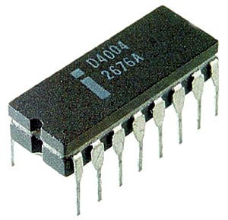
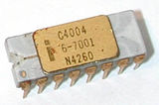
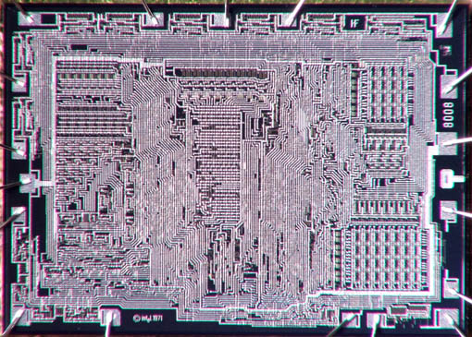
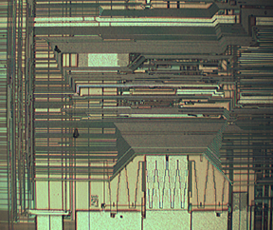
Pentium D processor in 2005
Pentium dual core 2007
Pentium core 2 duo 2008
And now the latest microprocessor is
Core i7
Photograph of the Intel’s first microprocessor
8008
80486

Slide 18
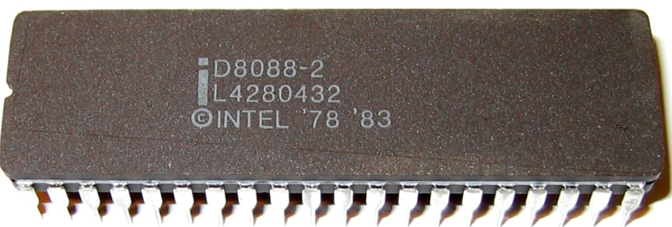
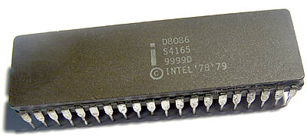
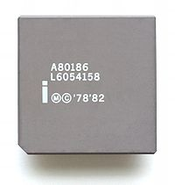
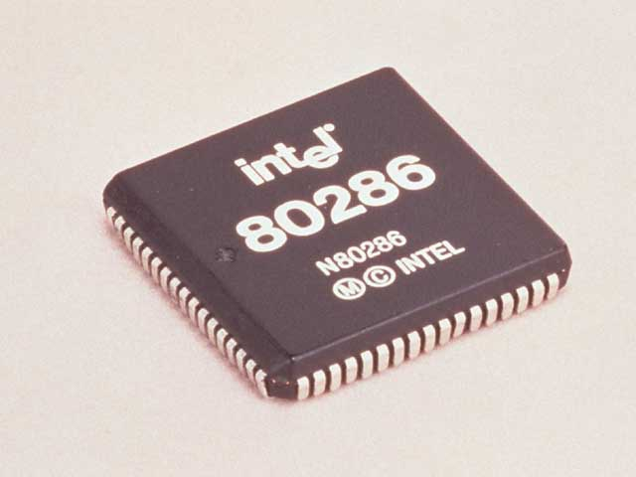
8088
8086
80186

Slide 19
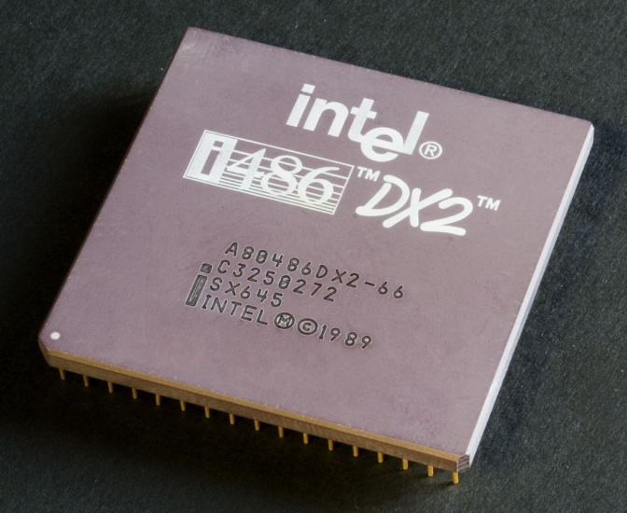
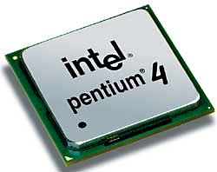
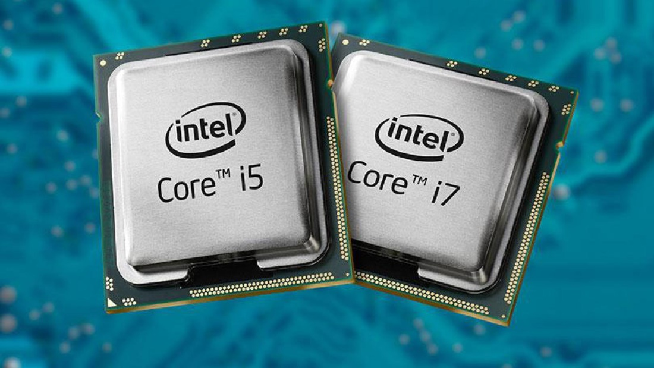
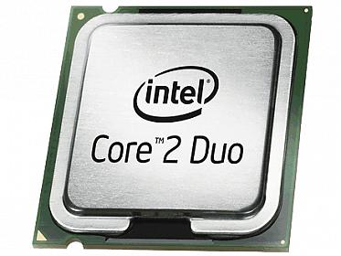
80486

Slide 20
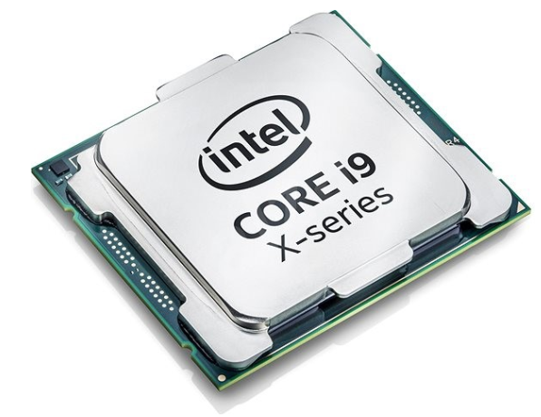
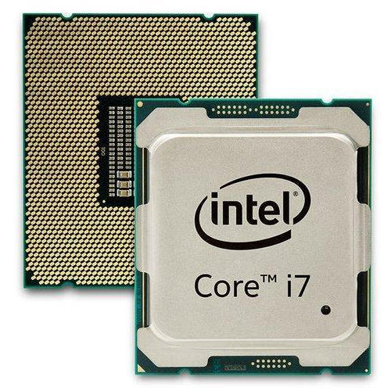

Slide 21
Types of Microprocessor: In response to the expressed needs, microprocessors have evolved in three major directions during the last 40 years.
DEDICATED CONTROLLERS
One direction has been dedicated controllers. These devices are used to control "smart" machines such as microwave ovens, clothes washers, sewing machines, auto ignition systems, and metal lathes. They are also called microcontroller. In fact a microcontroller itself is a complete computer with limited capacity. They also contain application specific units such as ADC (Analog to Digital Converter), Timer, PWM (Pulse Width Modulation) generator, Clock generator etc.. Texas Instruments produced millions of their TMS-1000 family of 4-bit microprocessors for this type of application.
ln 1976 Intel introduced the 8048, which contains an 8-bit CPU. RAM, ROM, and some I/O ports all in one 40-pin package. Other manufacturers have followed with similar products. Some currently available devices in this category are the PIC16f series.

Slide 22
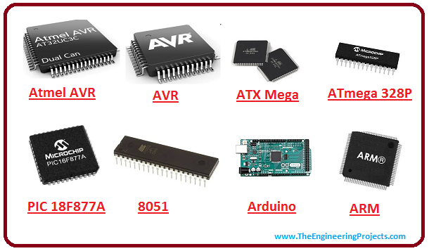
Advanced RISC Machine (ARM) Processor is considered to be family of Central Processing Units that is used in music players, smartphones, wearables, tablets and other consumer electronic devices. The architecture of ARM processor is created by Advanced RISC Machines, hence name ARM.

Slide 23
BIT-SLICE PROCESSORS
A second direction of microprocessor evolution has been bit-slice processors. For some applications general-purpose CPUs are not fast enough or their instruction sets are not suitable. For these applications several manufacturers produce devices which can be used to build a custom CPU. An example is the Advanced Micro Devices 2900 family of devices. This family includes 4-bit ALUs, multiplexers, sequencers, and other parts needed for custom-building a CPU. Intel’s bit slice family is 3000.
The set of instructions that a microprocessor can recognize (execute) is called instruction set.
8086: DIV ; division
PIC16f84: DIV not recognized. Repeatedly subtract.

Slide 24
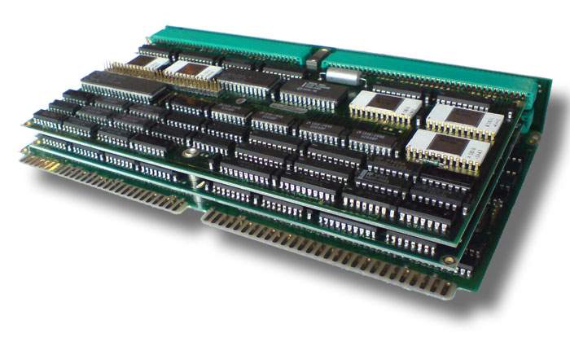
Bit Slice Processor
The term slice comes from the fact that these parts can be connected in parallel to work with 8-bit words, 16-bit words, or 32-bit words. In other words, a designer can add as many slices as needed for a particular application. The designer not only custom-designs the hardware of the CPU, but also custom-makes the Instruction set for it using "microcode."

Slide 25
GENERAL-PURPOSE CPUs
The third major direction of microprocessor evolution has been toward general-purpose CPUs which give a microcomputer most or all of the computing power of earlier minicomputers. All of the microprocessor we use in computers are general purpose microprocessors.

